Slide 1

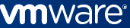
Network Analytics
Leveraging Applied AI and ML techniques for SDN
Faculty Guide: Mrs. R Senthil Prabha
Mentor: Mr. Sairam Veeraswamy

Slide 2
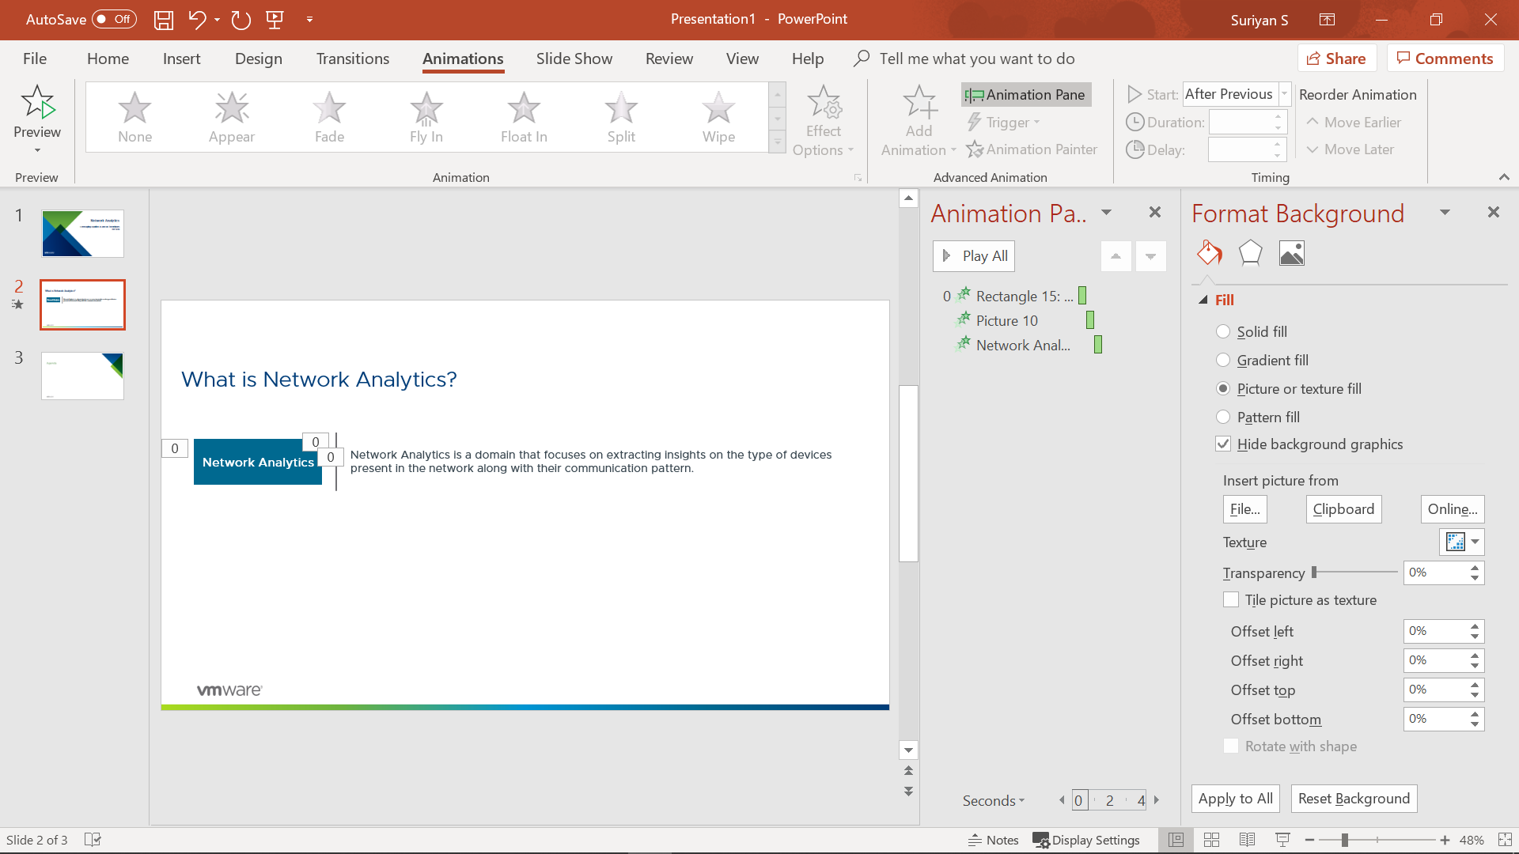
What is Network Analytics?
Network Analytics
Network Analytics is a domain that focuses on extracting insights on the type of devices present in the network along with their communication pattern.

Slide 3

1
Analytics on computer networks
2
Workflow of Network Data Analytics
3
Problem domains
4
Development environment
5
Work Done and further work

Slide 4
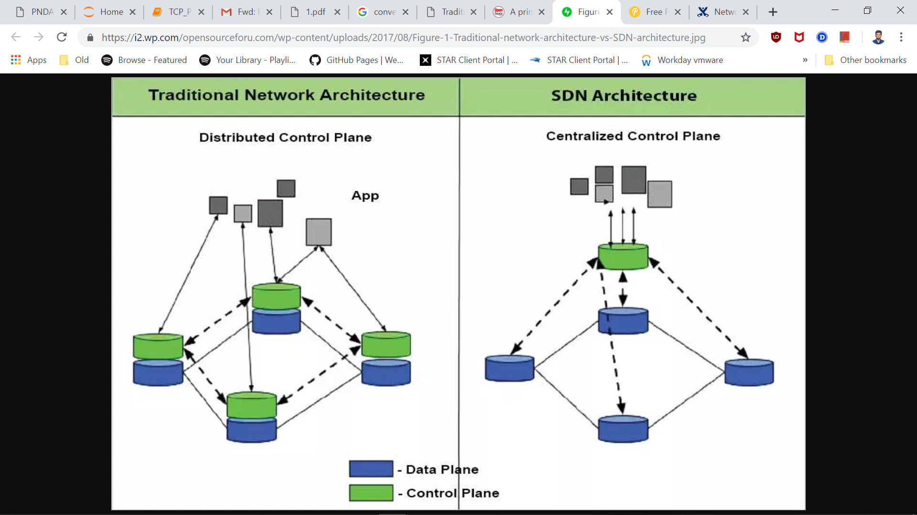

How analytics on network data is possible?
- Control plane
- Data plane
Image credits: Open Source Forum
Notes:
Analytics can be really costly which is not
Reduced complexity of networks
Complete view of the network made possible

Slide 5

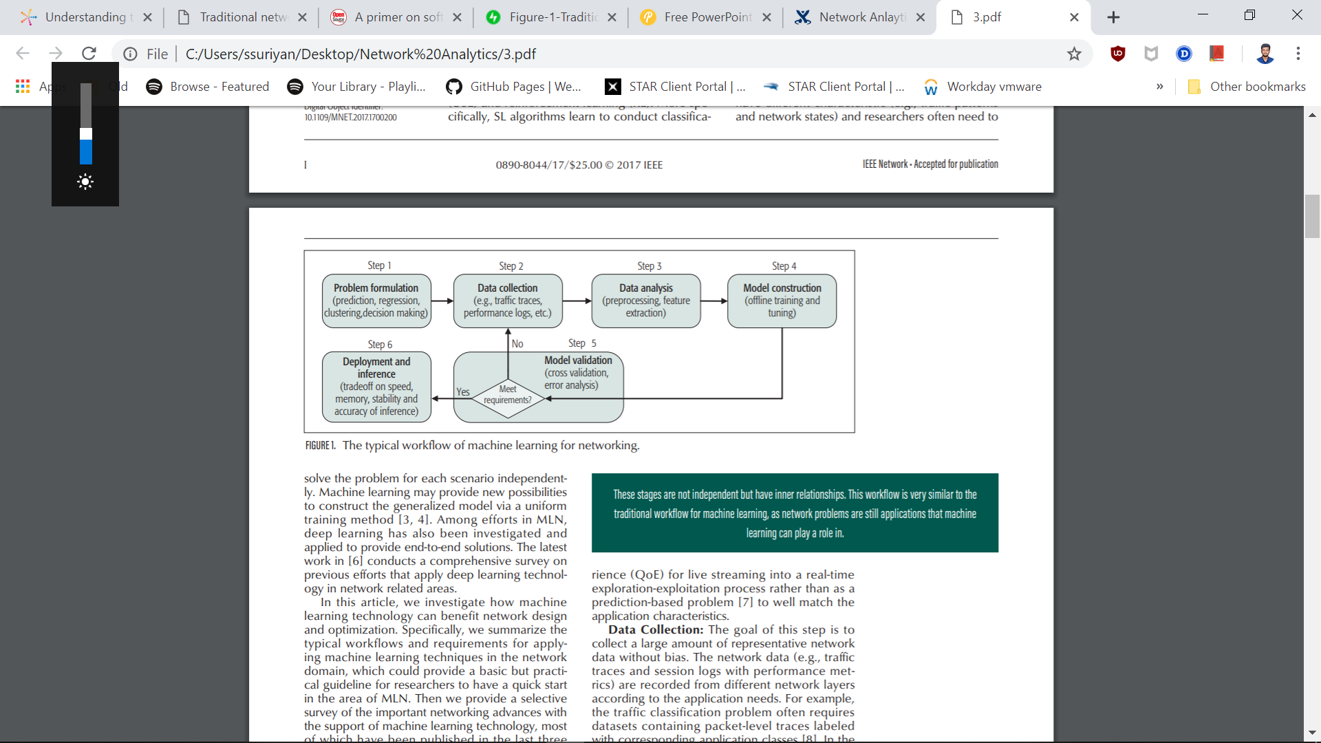
Workflow
Image credit: https://ieeexplore.ieee.org/document/8121867

Slide 6
Problem domains
Traffic Prediction
Classification
Routing
Congestion control
Resource management
Fault management
QoS and QoE Management
Network Security

Slide 7

Work Done
Researched related works done, by analyzing various research papers of the selected problem domain.
Shortlisted interesting use cases which were solved by various researchers and learnt them as well.
Deployed the development environment - PNDA
Went through different demos provided by PNDA.
Deployed the network simulator GNS3 for synthesizing dataset.
Simulated a network topology to collect network packet traces which can be used as dataset.
Developed a passive packet loss application to identify packet losses.

Slide 8

Development environment
PNDA - Platform for Network Data Analytics
GNS3(Graphical Network Simulator) with Wireshark

Slide 9
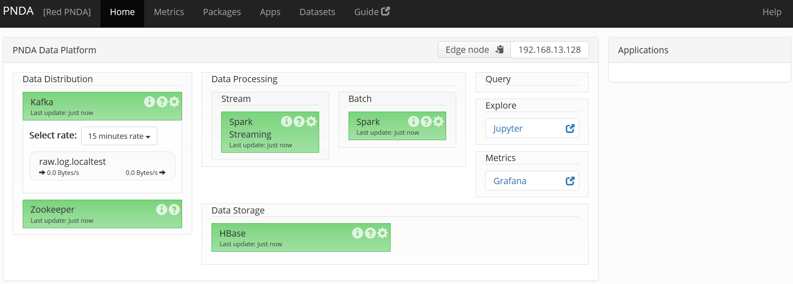
PNDA - Platform for Network Data Analytics
Data Ingestion
Data Distribution
Data Exploration

Slide 10
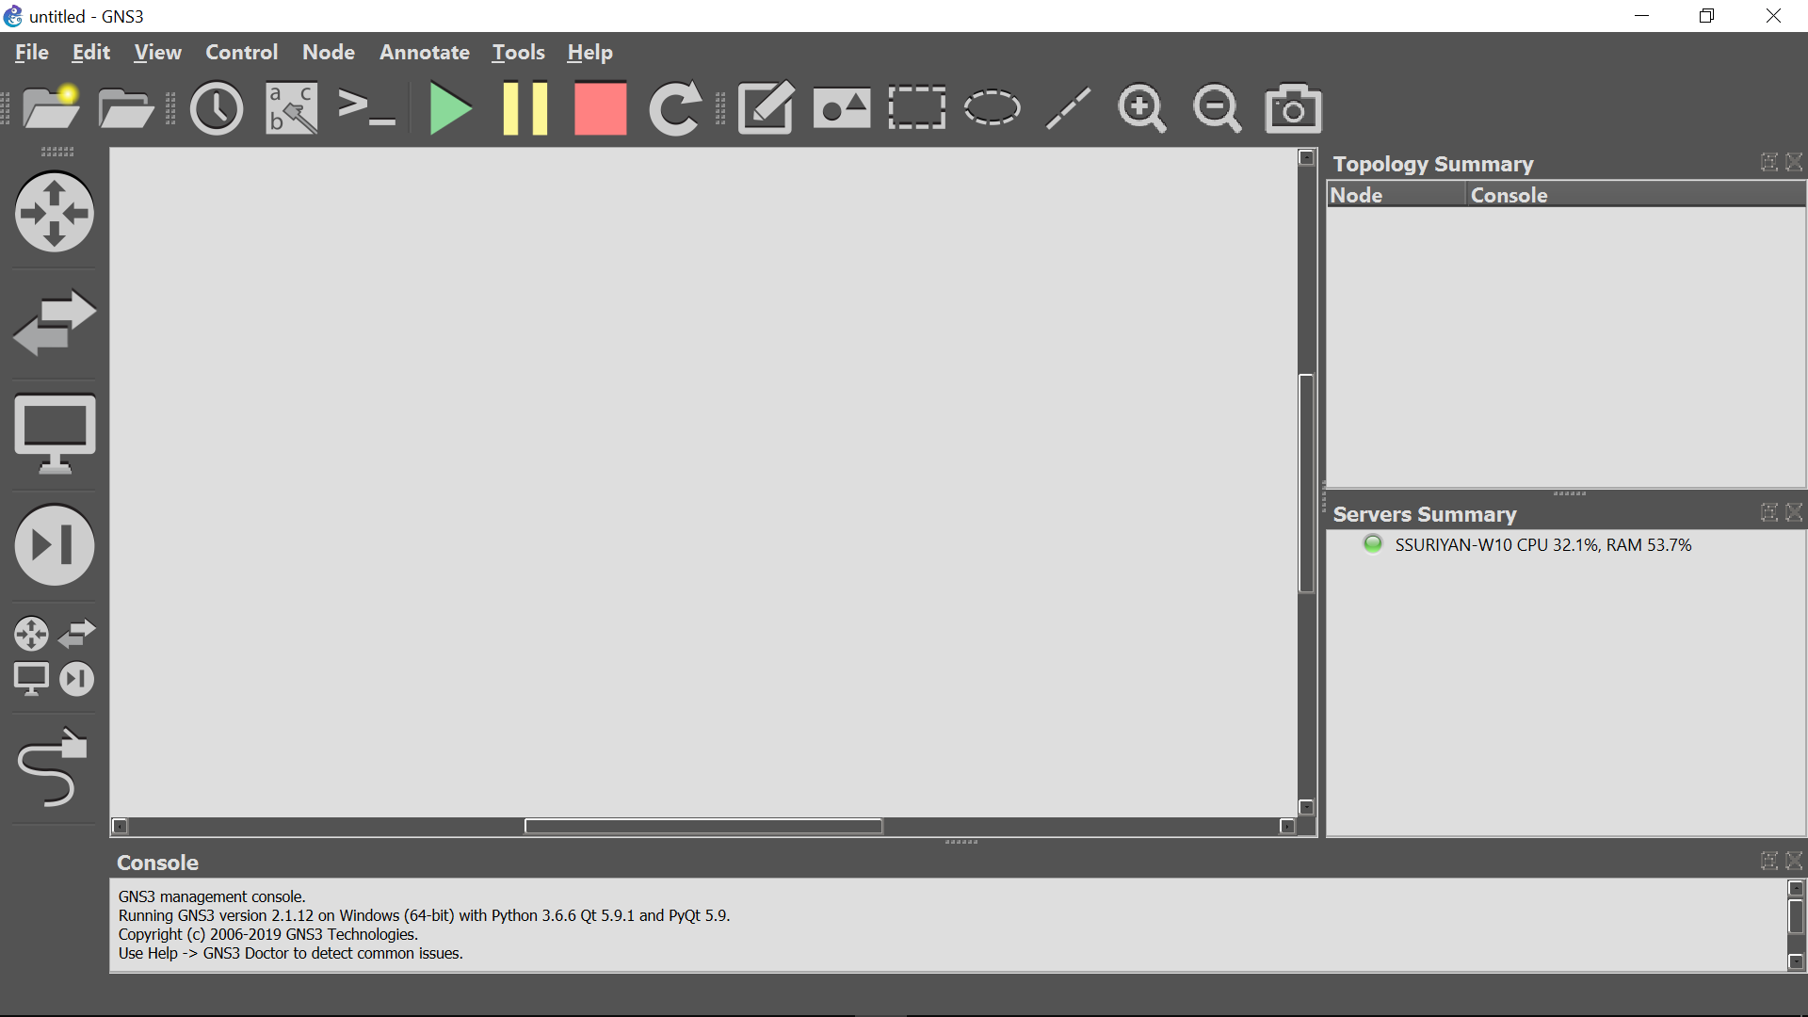
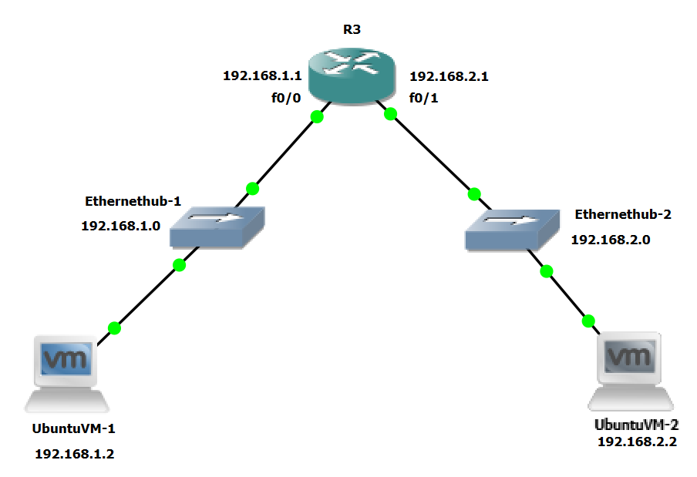
GNS3(Graphical Network Simulator) with Wireshark

Slide 11
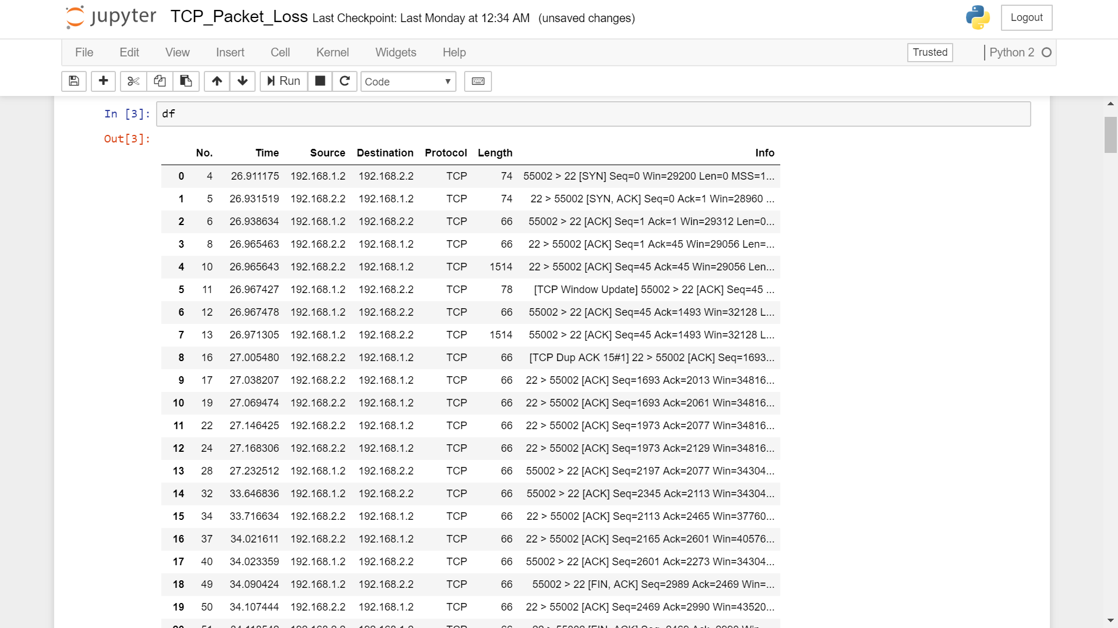
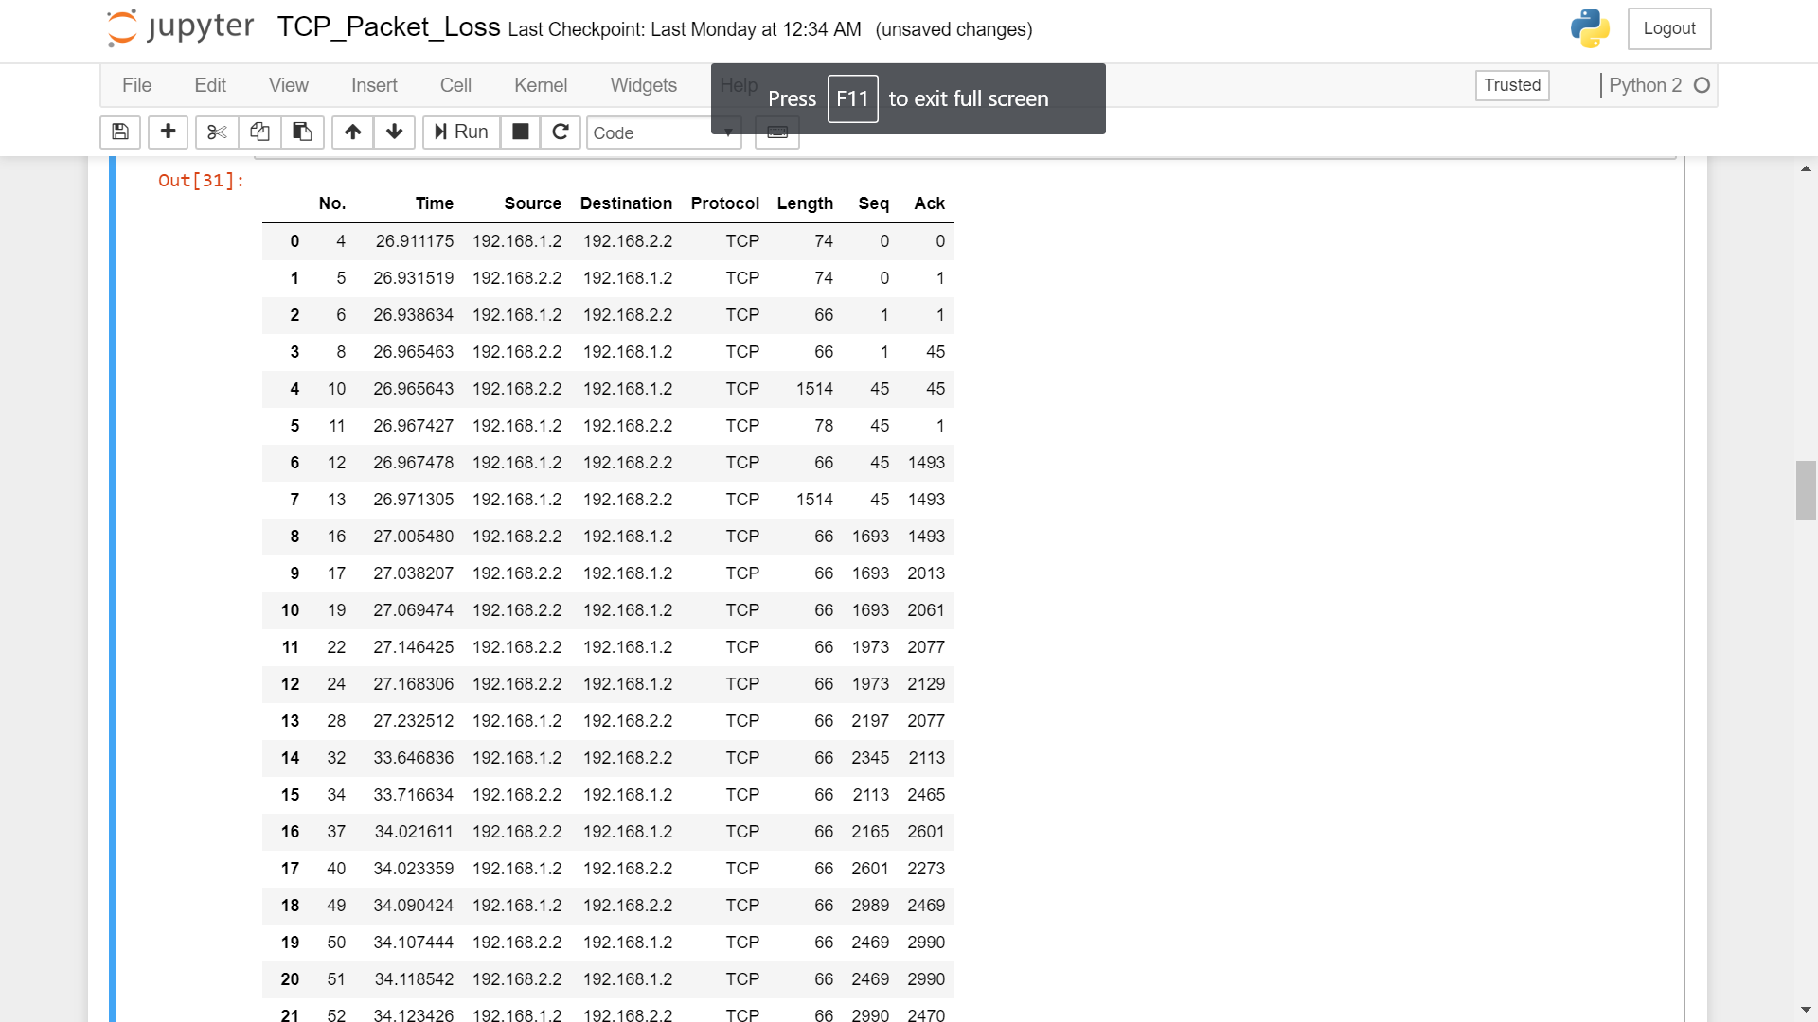
Synthesized dataset
Raw Data
Preprocessed Data

Slide 12
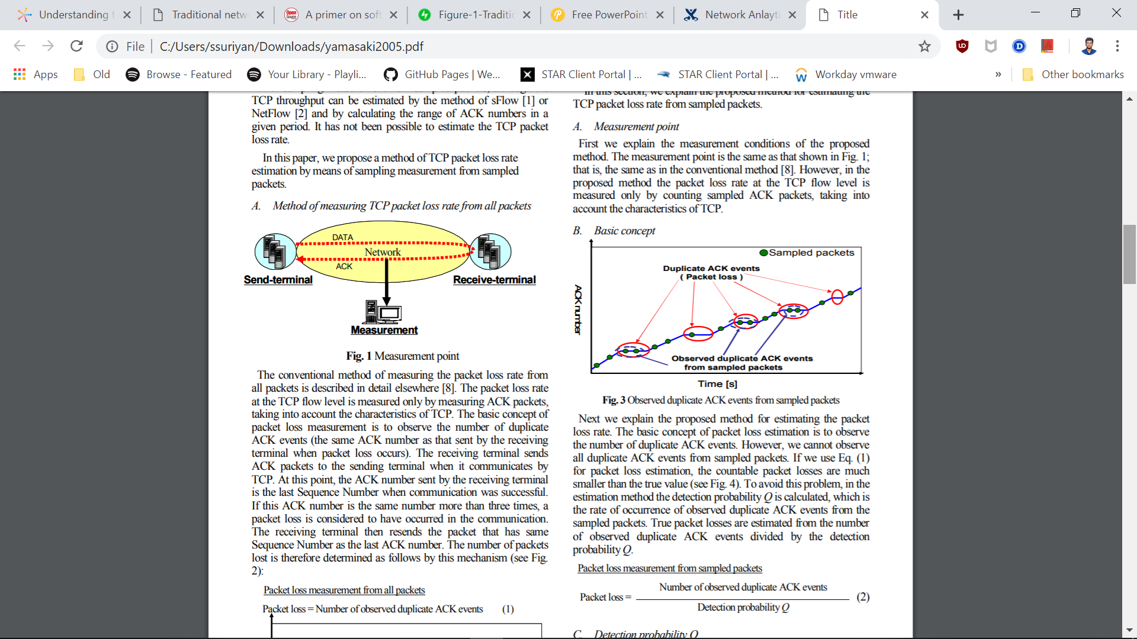
Packet Loss Identification
Image credits: https://www.semanticscholar.org/paper/Statistical-estimation-of-TCP-packet-loss-rate-from-Yamasaki-Shimonishi/0aa2dec5c73066f4d71aba5f1f2434ec18ac953e

Slide 13
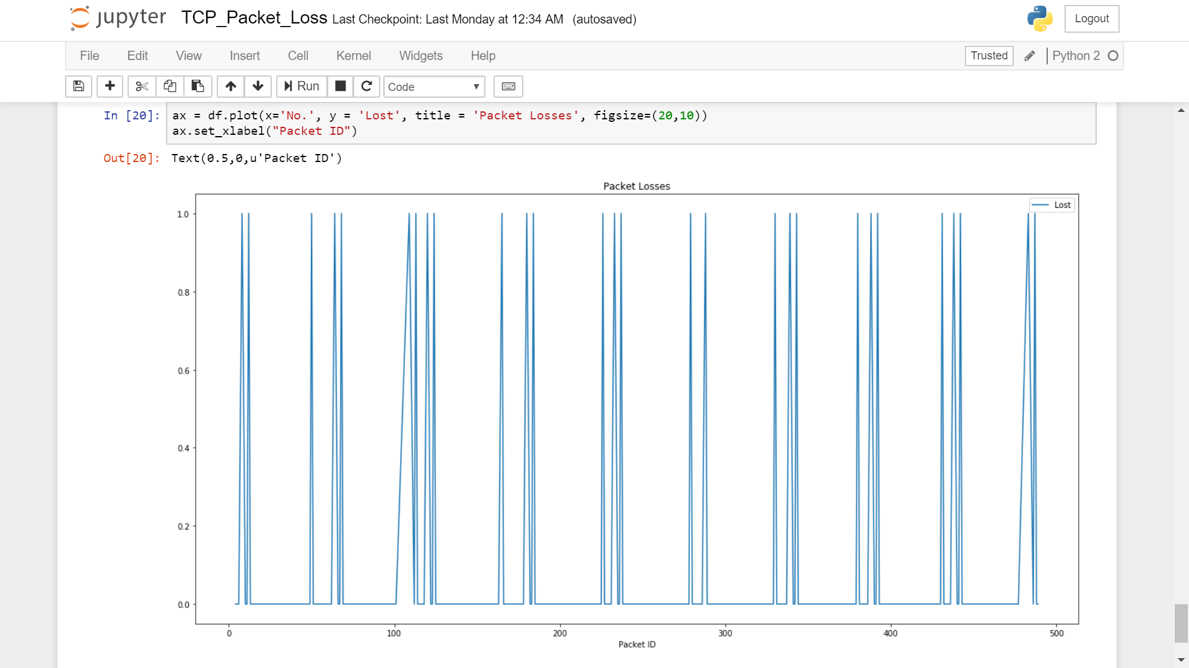
Packet Loss

Slide 14
Selected Domains:
Traffic Prediction
Resource Allocation
Further work
Selecting specific problems in each of these domains and developing analytics applications to solve them.

Slide 15
Timeline of the project
TIMELINE ACTIVITIES | January |  |  |  |  | February |  |  |  | March |  |  |  | April |  |  |  |  | May
 | 1 | 2 | 3 | 4 | 5 | 1 | 2 | 3 | 4 | 1 | 2 | 3 | 4 | 1 | 2 | 3 | 4 | 5 | 1 | 2 | 3 | 4
Project Requirement And Analysis
Development environment setup and sample application.
Module 1 Problem Formulation Data Collection Data Analysis
Module 2 Model construction and Model Validation
Paper publication and report submission
Work Planned
Work Completed
Work in progress

Slide 16
References
https://www.researchgate.net/publication/328932880_Artificial_Intelligence_Enabled_Software_Defined_Networking_A_Comprehensive_Overview
https://link.springer.com/article/10.1186/s13174-018-0087-2
Machine Learning for Networking: Workflow, Advances and Opportunities https://ieeexplore.ieee.org/document/8121867
Workshop on Self-Driving Networks — Workshop Report http://www.cs.princeton.edu/~jrex/papers/self-driving-networks18.pdf
On Analyzing Self-Driving Networks: A Systems Thinking Approach https://arxiv.org/pdf/1804.03116.pdf
Refining Network Intents for Self-Driving Networks http://www.inf.ufrgs.br/~granville/wp-content/papercite-data/pdf/p15_jacobs.pdf
Recent Advances in Machine Learning And Their Application to Networking http://www.1-4-5.net/~dmm/talks/2015/thursday_lunch_ietf93.pptx

Slide 17
THANKS

